Slide 1

Runtime()
It´s
SAP Inside Track Hannover 2019
Keynote
Marco Matjes

Slide 2

Matjes Institute
for Gallop Simulation
Hamburg

Slide 3
 |  |  | The Best Run MIG Algorithms
 |  |  |  |  |  |  |  |  |  |  |  | #1 | Overall Race Algorithm | Overall Race Algorithm
 |  |  |  |  |  |  |  |  |  |  |  | #2 | Slipstream Algorithms | Slipstream Algorithms
 |  |  |  |  |  |  |  |  |  |  |  | #3 | Hoofprint Analysis | Hoofprint Analysis
 |  |  |  |  |  |  |  |  |  |  |  | #4 | Splashwater Algorithm | Splashwater Algorithm
 |  |  |  |  |  |  |  |  |  |  |  | #5 | Photofinish Colourgrey Algorithm | Photofinish Colourgrey Algorithm

Slide 4
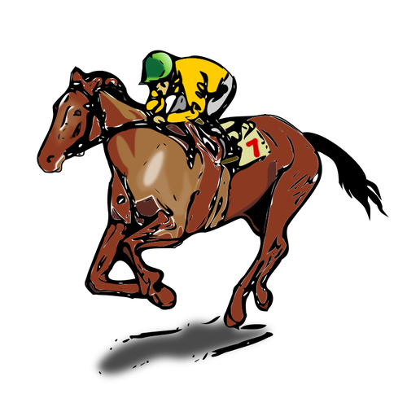
#1 Overall Race Algorithm
>> Live Demo 1
Meters in the hover phase = rounded integer value from (((basic speed fix value between 1480 and 1520) + (random value for the form on the day between 1490 and 1510) + (random loop factor value between 0 and 3000) [+ tactics factor 1200, 1500 or 1800] / 3 [or / 4 if tactics]) [+ slipstream factor 100 or 200])

Slide 5


#2 Slipstream Algorithms
>> Live Demo 2
Simple slipstream algorithm
(algoritmus ventus umbra simplex)
Double slipstream algorithm (algoritmus ventus umbra duplex)
a.k.a. “algoritmus subligar fluvius”
(scientifically not correct!)

Slide 6
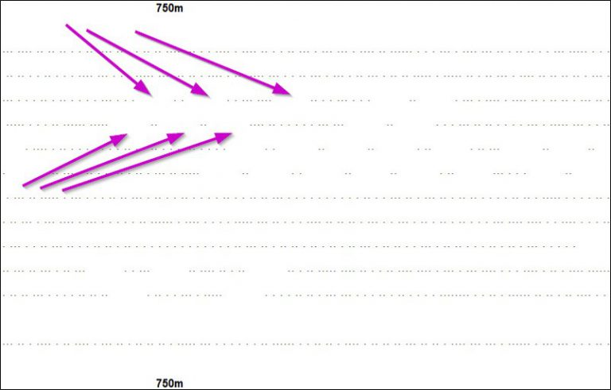
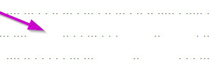
#3 Hoofprint Analysis
HPA [Switzerland, 2018]

Slide 7

#3 Hoofprint Analysis
HPA
[Switzerland, 2018]

Slide 8
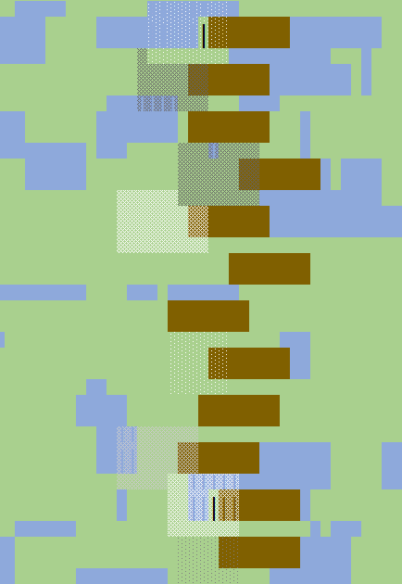

#4 Splashwater Algorithm
>> Live Demo 3
Squirt Logic
Log(S) = Water ⇒ (( Rnd (SQL) Rnd (SQP) Rnd (SQCol) ))
SQL Squirt Length
SQP Squirt Pattern
SQCol Squirt Colour (Fifteen Shades of Grey)
SQP/SQCol
SQL

Slide 9
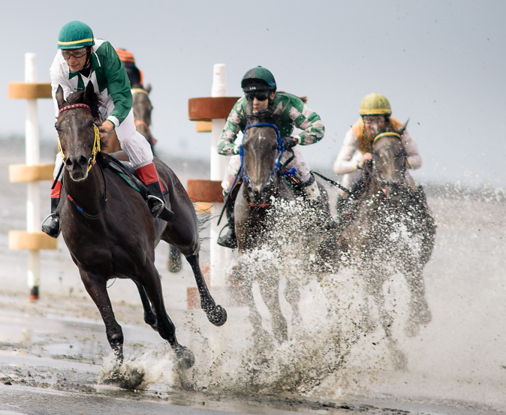
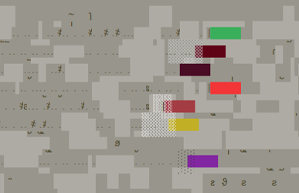
#4 Splashwater Algorithm
Research paper on http://matjes-institut.de/gb/gesamtwattalgorithmus/
Total Mudflat Algorithm
Source:
https://www.duhner-wattrennen.de/bildergalerie/2018/marc-chilla/
TMA = Splashwater Algorithm + Lugworm Algorithm
Squirt Logic

Slide 10
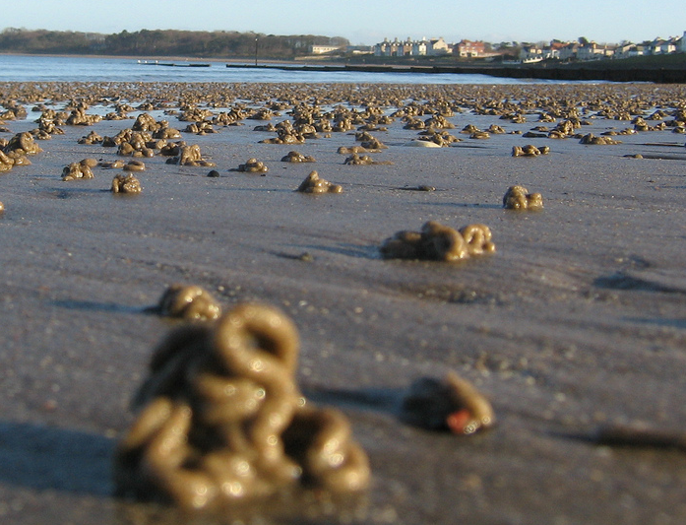
#4 Splashwater Algorithm
14 OMG characters + LCC
(Official MIG lugworm characters)
OMG lugworm character | ILC (International lugworm code)
~ | UTF-126
ƨ | UTF-424
ϑ | UTF-977
ϧ | UTF-999
ҩ | UTF-1193
(…) | (…)
҂ LCC („Lugworm crash character“) | UTF-1154
Source https://en.wikipedia.org/wiki/Lugworm#/media/File:Lugworm_cast.jpg

Slide 11
#5 Photofinish Colourgrey Algorithm

Slide 12
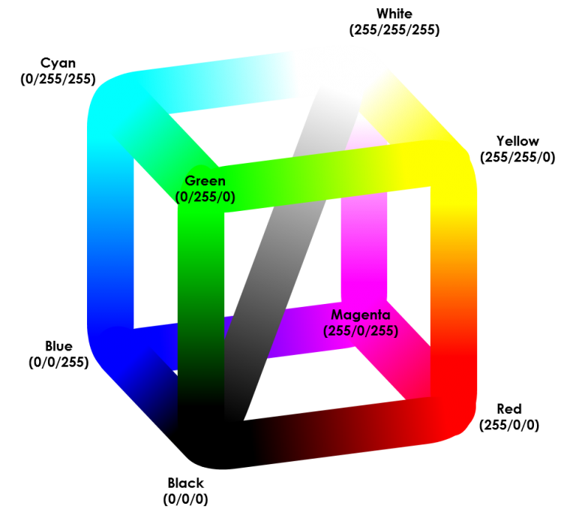
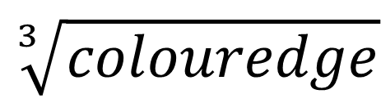
#5 Photofinish Colourgrey Algorithm
Research paper on http://matjes-institut.de/gb/zielfoto-farbgraualgorithmus/
Colourgreycube diagonal line
~1.7 → expected 443
$$\sqrt[3]{colouredge}$$
MIG discovery (2018): Existance of eternity grey (e.g.)

Slide 13

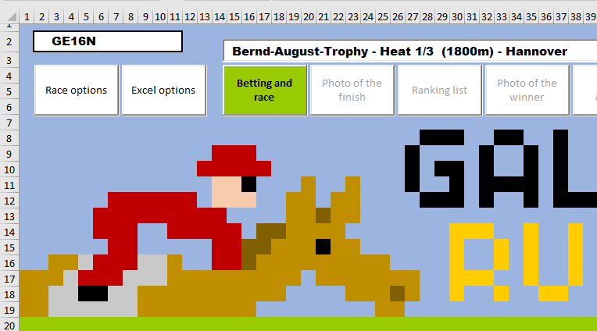

Planned features
Disclaimer
This slide is
CONFIDENTIAL
WOW effect (Wind or Weather)
GCODE
GAdI-Builder (GE18/GE19)
Eco-friendly race algorithms

Slide 14




Contact
http://matjes-institut.de/
https://galoppsim.racing/

